Slide 1
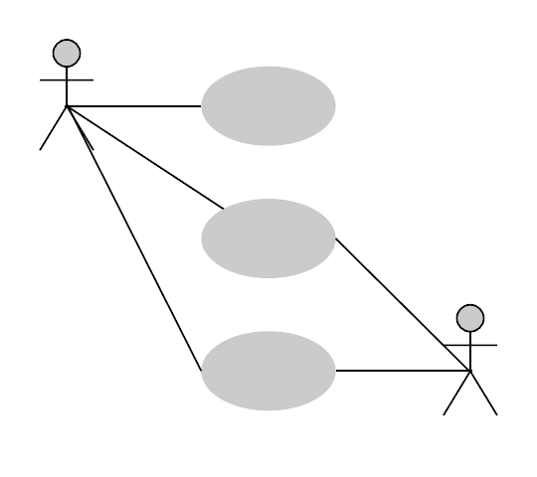
Object Oriented Design
Lecture 02
Use Case Diagram

Slide 2
Why Design Systems ?
“Without good software design, programming is an art of adding bugs to an empty text file” -Louise Srygley
Have you ever developed a software without a design?
How easy it was to make changes to your code?
Did a small code change produce a ripple-effect for changes elsewhere in the code?
Was your code hard to reuse?
Was the software difficult to maintain after a release?

Slide 3
A Good Software Design;
Allows changes
More flexible
Increases reusability
Easy to understand
Cost effective

Slide 4
UML (Unified Modeling Language)
Provides a standard way to visualize the design of a system.
UML can be described as the successor of object-oriented (OO) analysis and design.
An object contains both data and methods that control the data.

Slide 5
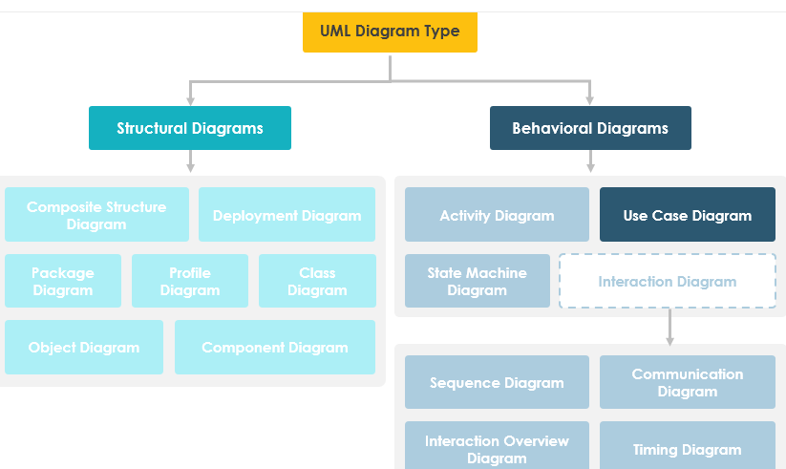
UML Diagrams

Slide 6
Use Case Diagram
Captures the Dynamic behavior of the system.
Dynamic behavior shows how the system works when it is running/operating.
A use case diagram is usually simple. It does not show the detail of the use cases:
It only summarizes some of the relationships between use cases, actors, and systems.
It does not show the order in which steps are performed to achieve the goals of each use case.
Use Case diagram is used to model the system/subsystem of an application. A single use case diagram captures a particular functionality of a system.
Hence to model the entire system, a number of use case diagrams are used.

Slide 7
Use Case Diagram
It is an excellent way to communicate to management customers and other non development people.
WHAT a system will do when it is completed.
BUT..it does not go into detail of HOW a system will do anything.
It illustrates to the development team exactly what is expected from a system.

Slide 8
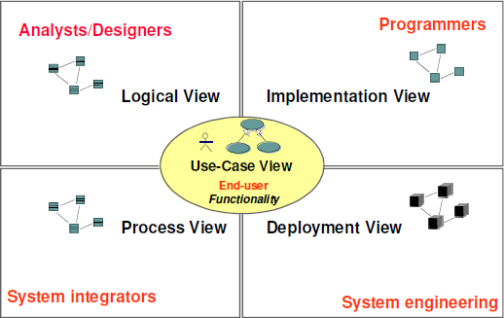
Views of a System

Slide 9
The Use Case View
Use Case View describes the behavior of the system as seen by its end users, analysts and testers.

Slide 10




Role of Use Case Diagrams in UML
Requirement Documents
Actors and Use cases
Workflows / Interaction behavior
Use Case Diagrams
Object Structure
Scenarios
Activity
Diagrams
Interaction Diagrams
Class Diagrams

Slide 11
Components of a Use Case Diagram
System : Something that performs function(s).
Actors : the roles adopted by those participating.
Use Cases : high level activities to be supported by the system.
Relationships / Links : which actors are involved in which use cases (dependency, generalization, and association)

Slide 12
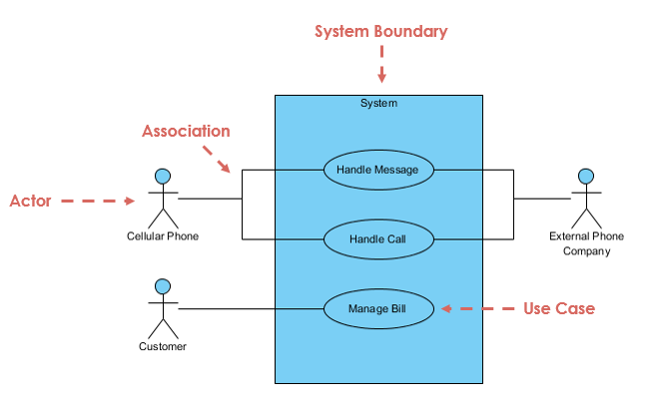

Slide 13
System / Subsystem
A system is a piece or multiple pieces of software that performs some sort of function for its users.
When modeling a very large system that could benefit from being broken down into more maintainable pieces.
Example :
Banking Application
Account Creation
Money Transaction
Balance Check
Apply Loan

Slide 14

Actors
An Actor represents an entity in the outside world that takes on the role of interacting with the software system.
An actor can be
A user (i.e. Human)
Another software system
A hardware device (with embedded software)
Customer
Paypal
Printer

Slide 15
How to Determine the Actors?
who uses the system?
who gets information from the system?
who provides information to the system?
who installs, starts up or maintains the system?

Slide 16
Task one – Identifying Actors
It is required to automate the following manual process on student assessments.
Traditionally, a student’s performance on each taught module in the Software Engineering course can be assessed in two ways:
By written report before, during and after the module, which is marked by the lecturers.
By a written exam, which is taken by the students under formal invigilated conditions and then marked by the lecturers.
The lecturers may choose what weight is given to each form of assessment or, indeed, whether one of the two forms is dropped.
For audit purposes, copies of all assessment material and marking schemes must be presented to the department’s office for safekeeping.
After the completion of each module’s assessment or exam, as appropriate, student marks are presented to the registry.
To get the student details the registration system is accessed.

Slide 17
Use Cases
Use Case represents a sequence of events (actions) which combined to form some interaction between the software system and the outside world.
Every use case must have a name that distinguishes it from other use cases.
In practice, use case names are short active verb phrases naming some behavior found in the vocabulary of the system you are modeling.
Display Balance

Slide 18
How to Determine Use Cases?
Which functions/services do actors require from the system ? What does the actor need to do?
Does the actor need to read, create, destroy, modify or store some kind of information in the system?
Does the actor need to get notified when some events occur in the system?
Can some actors daily work be simplified by functionalities in the system? If so, what work?

Slide 19
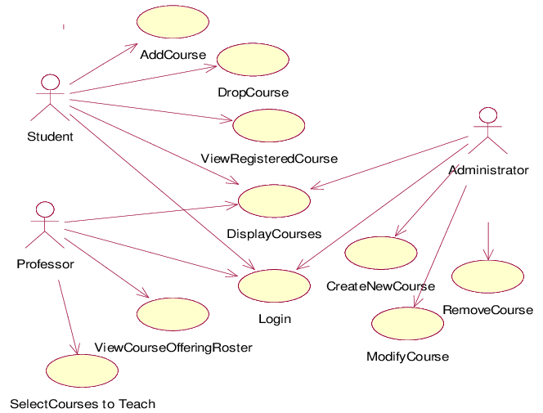
Example

Slide 20
Task two – Identifying Use Cases
It is required to automate the following manual process on student assessments.
Traditionally, a student’s performance on each taught module in the Software Engineering course can be assessed in two ways:
By written report before, during and after the module, which is marked by the lecturers.
By a written exam, which is taken by the students under formal invigilated conditions and then marked by the lecturers.
The lecturers may choose what weight is given to each form of assessment or, indeed, whether one of the two forms is dropped.
For audit purposes, copies of all assessment material and marking schemes must be presented to the department’s office for safekeeping.
After the completion of each module’s assessment or exam, as appropriate, student marks are presented to the registry.
To get the student details the registration system is accessed.

Slide 21
Use Case Relationships
Relationships may exist;
Between Use Cases – Include, Extend, Generalization
Between Actors- Generalization
Between Actors and Use Cases - Association

Slide 22
Use Case Relationships
1) Relationship Types Between Use Cases;
Association: Indicates that an actor participates in (i.e. communicate with) the use case.
Include : Indicates that the behavior of one use case includes the behavior of a another.
Extend : Indicates that one use case may be extended by (subjected to specific conditions) by the behavior of another.
Generalization : Indicates that one use case inherits the properties of another with the usual possibilities for overriding and substitution.
<<include>>
<<extend>>

Slide 23
Use Case Relationships
2) Relationship Types Between Actors;
Association: Indicates that an actor participates in (i.e. communicates with) the use case.
Generalization : Indicates that an instance of one actor can communicate with the same use cases as instance of another.

Slide 24
Use Case Relationships
3) Relationship Types Between Actors and Use Cases;
Association: The ONLY relationship between actors and use cases shown by association.

Slide 25
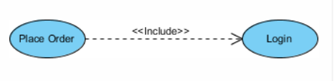
Include (uses) Relationship
When a use case is depicted as using the functionality of another use case, the relationship between the use cases is named as include or uses relationship.
A use case includes the functionality described in another use case as a part of its business process flow.
A uses relationship from base use case to child use case indicates that an instance of the base use case will include the behavior as specified in the child use case.

Slide 26
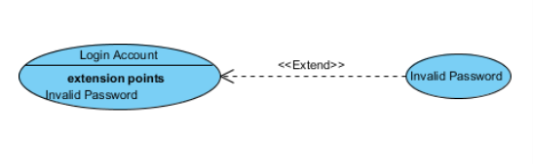
Extend Relationship
The base Use Case is a complete Use Case in its own right, which may have its behavior extended by another Use Case when specific conditions arise.
An extend relationship is to model the part of a use case the user may see optional system behavior.
In this way, separating optional behavior from mandatory behavior.
Extending Use Case
Extended Use Case
Notes:
Base UC can have multiple extension points.

Slide 27
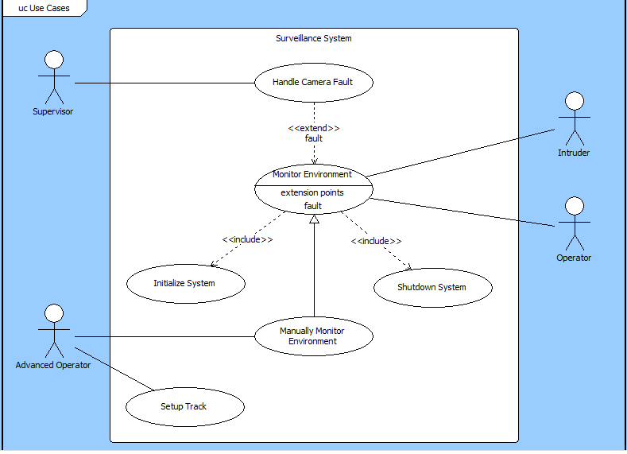

Slide 28
Generalization Relationship
A generalization relationship is a parent-child relationship between use cases.
The child use case is an enhancement of the parent use case.
Payment
Payment by credit
Payment by cash
Notes:
Base UC can have multiple extension points.

Slide 29
Actor Generalization
Actor Generalization is drawn from the concept of inheritance in Object Oriented Programming.
Child actor inherits all of the characteristics and behavior of the parent actor.
Can add to, modify or ignore any of the characteristics of the parent actor.
User
Registered User
Unregistered User

Slide 30
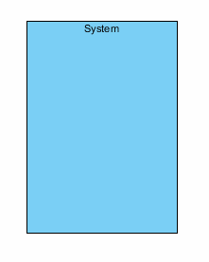
System Boundary
The system boundary is potentially the entire system as defined in the requirements document.
For large and complex systems, each module may be the system boundary.
For example, for an ERP system for an organization, each of the modules such as personnel, payroll, accounting, etc.
Can form a system boundary for use cases specific to each of these business functions.
The entire system can span all of these modules depicting the overall system boundary

Slide 31
Case Study 1 – Theatre Ticketing System
The following is a description of the activities of a box office clerk interacting with a theatre ticket booking system.
On receiving a request for tickets from a customer, the clerk must firstly set up an order on the system.
She then asks the customer if the order is a single order or a subscription order. Members of the theatre are entitled to place subscription orders.
If a single order, the clerk assigns the seats on the system and charges the customer's credit card.
If on the other hand, it is a subscription order, the clerk assigns the seats and debits the customer's account at the same time as awarding the customer a member's bonus. In both cases, the

Slide 32
Case Study 2 - The Bank Account
You are asked to design a system to handle
current and savings accounts for a bank.
Accounts are assigned to one or more customers, who may make deposits or withdraw money.
Each type of account earns Interest on the current balance held in It.
Current accounts may have negative balances (overdrafts).
On a savings account there Is a maximum amount that can be withdrawn in one transaction.

Slide 33
Case Study - The Bank Account
Bank employees may check any account that is held at their branch. They are responsible for invoking the addition of interest and for issuing statements at the correct times.
A money transfer is a short lived record of an amount which has been debited from one account and has to be credited to another.
A customer may create such a transfer from their account to any other.
Transfers within a branch happen immediately,
while those between branches take three days.

Slide 34
Your Turn..
Draw the Use Case Models

Slide 35
Case Study – Library System
Librarian can add books to the library catalogue when new books are available in the library. Librarian can remove books from the library catalogue when needed. Member can reserve books which he/she wishes to borrow. Library Manager can take a list of books available in the Library. Furthermore he/she can add or remove any books from the Library catalogue when needed. When member is reserving the books he/she has to login to the system. Member can renew the books he/she has borrowed. When renewing if book has exceeded the loan period a fine will be calculated. For renewing purposes the member should login to the system. Library Manager can generate reports of the Borrowed books, Overdue books at the end of each month.

Slide 36
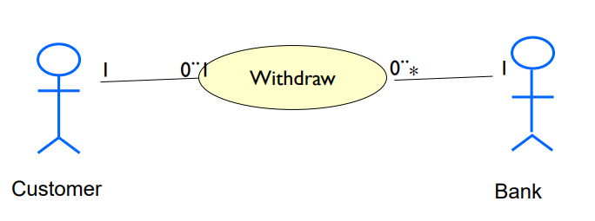
Multiplicity in Use Case
The uses connector can optionally have multiplicity values at each end, as in the following diagram which shows that a customer may only have one withdrawal session at a time, but a bank may have any number of customers making withdrawals concurrently.

Slide 37
Use Case Scenarios

Slide 38
Use Case Scenarios
A Scenario is a formal description of the flow of events that occur during the execution of a Use Case instance. It defines the specific sequence of events between the system and the external actors.
There is usually a Main scenario, which describes what happens when everything goes according to the plan. It is written under the assumption that everything is okay, no errors or problems occur, and it leads directly to the desired outcome of the use-case.
Other scenarios describe what happens when variations to the main scenario arise, often leading to different outcomes.

Slide 39
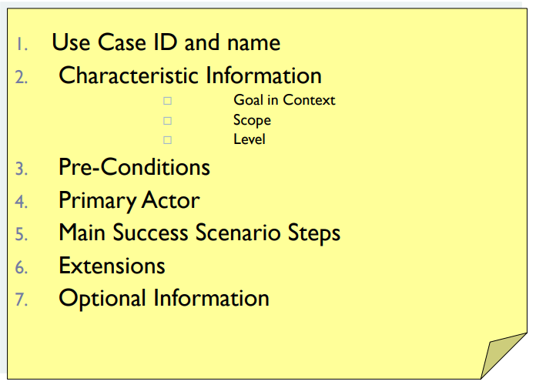
Sample Template

Slide 40
Exercise 01
Write down Use case scenario for withdraw money from an ATM.

Slide 41
Include / Extend : Textual Description
The text description of the Base Use Case contains references to any included Use Cases and any extension point(s).
Eg:- The RentVideo Use Case begins when the member is identified.
Basic flow:
1. include (Identify Member).
2. extend(late fine).
3. The rental transaction is then performed.
4. include (Process Rental).

Slide 42
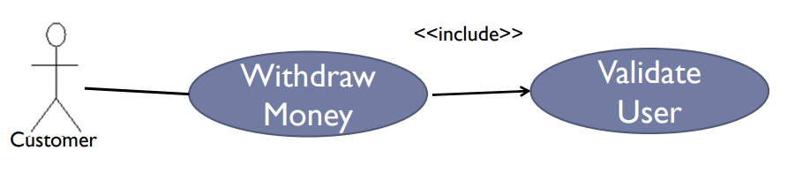
Exercise 01 Con.

